Slide 1

www.southsalemchurch.com
Facebook: Friend “South Salem Church” for video postings

Slide 2
The most disputed and studied Gospel
Great differences between the Gospel of John & the Synoptic Gospels
  Less focus on parables & proverbs, longer dissertations with disciples
  Cleansing of the Temple takes place at different times; chronological issues
  Was Jesus crucified before or after Passover? And what time? (differences)
Because of great differences, some discount John as an authentic Gospel
  John Dominic Crossan – The Historical Jesus
  The Jesus Seminar – The Five Gospels
  F.C. Burkitt – “only possibility is that the work is not history, but something else in historical form . . . It is a deliberate sacrifice of historical truth, and as the evangelist is a serious person in deadly earnest, we must conclude that he cared less for truth than for something else.” (The Gospel History and Its Transmission. Edinburgh: T. & T. Clark, 1906. pp. 225, 228)

Slide 3
Authorship:
“In the first instance, Westcott observed that it was obvious that the author had to be a Jew. He was certainly familiar with popular Messianic expectations (1:20-21, 7:40-42) as well as traditional Jewish customs like circumcision on the eighth day (7:22-23). Furthermore, the author was quite familiar with the open hostility between the Jews and Samaritans (4:9).”
  Ray Madrigal. “John Among the Synoptic Gospels”. God So Loved: Studies in the Gospel of John. Florida College Press: Temple Terrace, FL. Pp. 6.
“The contrast of light and darkness that appears in the first chapter has frequently been regarded as evidence of a Hellenistic influence in the Gospel. Yet the discovery at Qumran of the Jewish writing The War of the Sons of Light and the Sons of Darkness shows that this contrast was current in Judaism during the intertestamental period and was not necessarily an importation from Hellenism.”
  Merrill C. Tenney. “The Gospel of John”. The Expositor’s Bible Commentary: John and Acts. Zondervan: Grand Rapids, Michigan. Pp. 6-7.
Internal Evidence:
1. Was a Jew

Slide 4
Authorship:
“His knowledge of Palestinian topography was accurate. He distinguished between Bethany, the suburb of Jerusalem where Mary and Martha lived (11:1), and ‘Bethany on the other side of the Jordan,’ where John the Baptist preached (1:28). Some of the sites he alluded to, such as Aenon (3:23) and Ephraim (11:54), are not described elsewhere; but, obviously, they were actual places well known to him. His descriptions of the features of Jerusalem, such as the pool by the ‘Sheep Gate’ (5:2), the ‘pool of Siloam’ (9:7), the ‘Stone Pavement’ (Gr. Lithostroton, 19:13), and the varied references to the temple (2:14-16; 8:20; 10:23), show that he was familiar with the city before its destruction. (The devastation was so complete by the middle of the second century that the face of the city had changed entirely.)”
  Tenney. “The Gospel of John”. Pp. 6.
Internal Evidence:
1. Was a Jew
2. Palestinian Jew

Slide 5
Authorship:
“Notice the use of first-person plural: ‘the Word became flesh and dwelt among us, full of grace and truth; we have beheld his glory . . . .’ (1:14). Later, in the episode at Bethany when Mary anointed Jesus with costly ointment, the writer explains that the entire ‘house was filled with the fragrance of the ointment’ (12:3). One gets the impression the author is describing from memory the vivid and unforgettable smell of the occasion. More explicit, though, is the author’s direct claim to having firsthand, empirical knowledge of the varied events surrounding the crucifixion. . . It is at this point in the story where the author intrudes into the narrative: ‘He who saw it has borne witness – his testimony is true, and he knows that he tells the truth – that you also may believe’ (19:35).”
  Madrigal. “John Among the Synoptic Gospels.” pp. 7.
Internal Evidence:
1. Was a Jew
2. Palestinian Jew
3. Eyewitness to events recorded

Slide 6
Authorship:
“He was also closely acquainted with the personal career of Jesus from beginning to end. The author was aware of the thinking of the disciples, and apparently he shared their interests and hopes. He reports the private discourses of Jesus at some length; and even though the criticism has been raised that they are given in the Johannine style rather than in the epigrammatic style quoted in the Synoptics, some quotations in the Synoptics show that Jesus occasionally used the same language when alluding to himself (Matt 10:24-27; 26:64). Even if the author reported Jesus’ words in his own style, he cannot justly be charged with inaccuracy. Also, he shows knowledge of Jesus’ inner consciousness that would have been possible only to a close associate (6:6, 61, 64; 13:1-3, 11; 18:4).”
  Tenney. “The Gospel of John”. Pp. 7.
Internal Evidence:
1. Was a Jew
2. Palestinian Jew
3. Eyewitness to events recorded
4. Apostolic Authorship

Slide 7
Authorship:
“The strongest line of evidence for this conclusion is found in the description of the beloved disciple, especially in the final chapter of the Fourth Gospel (21:7, 20, 24; cf. 13:23; 19:26). The scene opens with Jesus making a memorable appearance at the Sea of Tiberias to seven of his disciples, including Peter, Thomas the Twin, Nathanael of Cana, the sons of Zebedee and two other disciples who’s names are not mentioned. Westcott is certain that the author of the Fourth Gospel ‘must have been either one of the sons of Zebedee, or one of the two disciples not described more particularly.”
  Madrigal. “John Among the Synoptic Gospels”. Pp. 8.
“By process of elimination, it seems reasonably certain that this anonymous disciple and author must have been John the son of Zebedee. Peter did not write the fourth Gospel, for it mentions him frequently in the third person. James the son of Zebedee did not write it, for he was executed by Herod Agrippa I prior to A.D. 44 (Acts 12:2). The remaining possibility is John, who fits the requirements of its authorship quite well.”
  Tenney. “The Gospel of John”. Pp. 7.
Internal Evidence:
1. Was a Jew
2. Palestinian Jew
3. Eyewitness to events recorded
4. Apostolic Authorship
5. Must be John

Slide 8
Authorship:
“Matthew composed a written Gospel for the Hebrews in their own language, while Peter and Paul were preaching the gospel in Rome and founding the church there. After their deaths, mark too, the disciple and interpreter of Peter, handed on to us in writing the things proclaimed by Peter. Luke, the follower of Paul, wrote down in a book the Gospel preached by him. Then John, the disciple of the Lord who had rested on his breast, produced a Gospel while living at Ephesus in Asia.”
  Irenaeus. Against Heresies. 5.8.1.
Gospel attributed to “John, the companion of Peter, James, and the other apostles” by Eusebius (Historia Ecclesiastica. 3.34.5.)
External Evidences:
Irenaeus bishop of Lyons (fl. C. 180)
Theophilus of Antioch (fl. C. 165)
Clement of Alexandria (fl. C. 220)
Tertullian of Carthage
Tatian (fl. C. 150)
Eusebius – church historian of 4th cent.

Slide 9
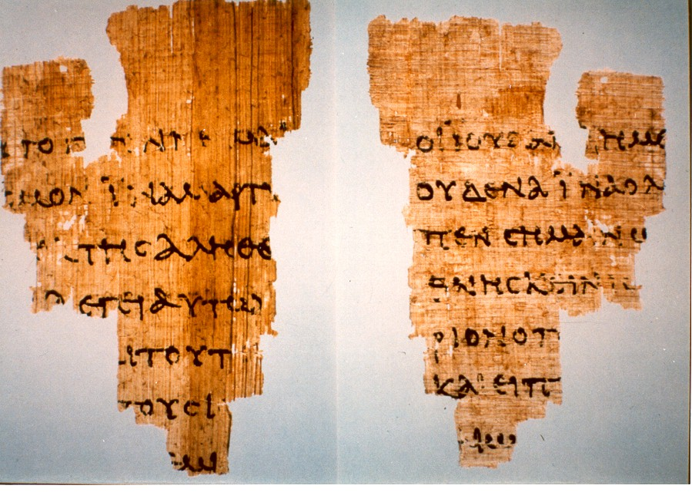
Date: much more certain
Generally attested to within 30 years between 80 AD and 110 AD
John Rylands fragment by C.H. Roberts 1935 – John 18:31-33, 37-38
  Incorporated in papyrus MS that cannot be dated any later than 135
  Therefore would have been written and circulated earlier than this copy
  Egerton papyrus (roughly same time) alludes to Gospel of John

Slide 10
Purpose: Why Did John Write It?
John 20:31 (ESV) ³¹ but these are written so that you may believe that Jesus is the Christ, the Son of God, and that by believing you may have life in his name.
“It is quite likely that the Gospel of John was written for a variety of reasons, including the correction of heresies among the Jews, who rejected Jesus as the Christ, and heresies among some Christians, who claimed that Christ did not really come in the flesh (cf. Docetism) . . . While we may discover several secondary aims and objectives to the Fourth Gospel, they all serve to complement its primary purpose: to produce and sustain faith in Jesus as the Christ!”
- Madrigal. “John Among the Synoptic Gospels”. Pp. 11-12.

Slide 11
Different Ways to Outline the Gospel of John
Divided Into Two Parts
Outline of Stages of Belief
“The Fourth Gospel, like the Apocalypse, can naturally be divided into two parts. The last paragraph of chapter twelve presents a concise summary of the may signs that Jesus had performed (12:37-50) and the next chapter opens with a distinct change in orientation, as Jesus prepares for his passion (13:1).”
- Madrigal. “John Among the Synoptic Gospels”. Pp. 12.
The Prologue: The Proposal for Belief (1:1-18)
The Presentation for Belief (1:19-4:54)
The Reactions of Belief & Unbelief (5:1-6:71)
The Crystallization of Belief & Unbelief (7:1-11:53)
The Crisis of Belief & Unbelief (11:54-12:50)
The Assurance for Belief (13:1-17:26)
The Rejection by Unbelief (18:1-19:42)
The Vindication of Belief (20:1-31)
Epilogue: The Dedication of Belief (21:1-25)
  Tenney. “The Gospel of John”. Pp. 13.

Slide 12
Other Unique Aspects to the Gospel of John
The “Kingdom of God” is only spoken of twice in John (3:3, 5).
Seven Signs Recorded by John
  Water into Wine (1:19-51); Official’s son healed (4:43-54); Paralytic Healed at Sheep Gate Pool (5:1-18); Feeding of 5000 (6:1-15); Walking on water (6:16-21); Healing of blind man (9:1-41); Lazarus raised from dead (11:1-54)
Seven “I Am” Statements by Jesus
  I Am the Bread of Life (6:35, 48)
  I Am the Light of the World (8:12, 9:5)
  I Am the Door (10:9)
  I Am the Good Shepherd (10:11, 14)
  I Am the Resurrection and the Life (11:25)
  I Am the Way, the Truth, & the Life (14:6)
  I am the True Vine (15:1, 5)

