Slide 1
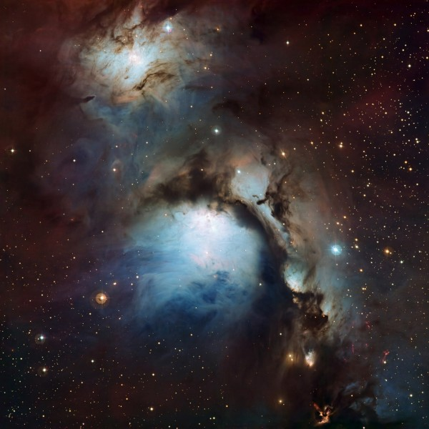

The final vengeance of God
Revela ion

Slide 2
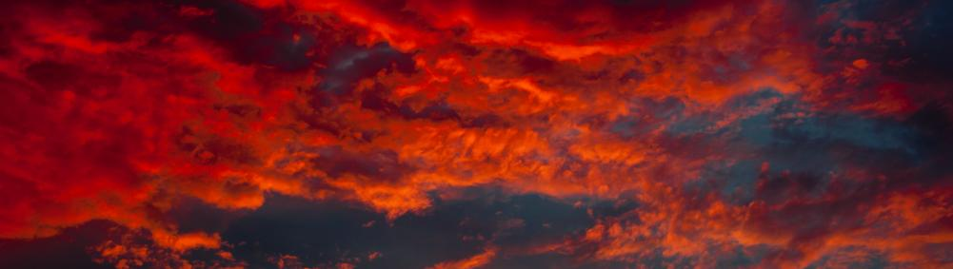
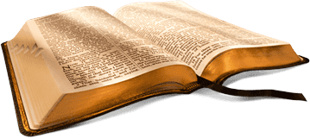
Revelation
The Revelation of Jesus Christ, which God gave Him to show to His bond-servants, the things which must soon take place; and He sent and communicated
it by His angel to His bond-servant John.

Slide 3
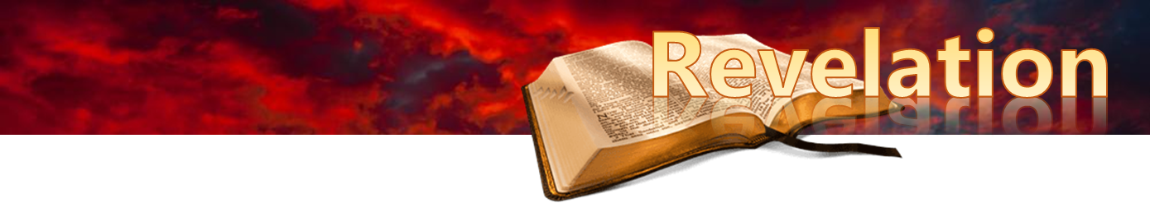
Tonight:
  Introduction concluded
  Revelation chapter One

Slide 4
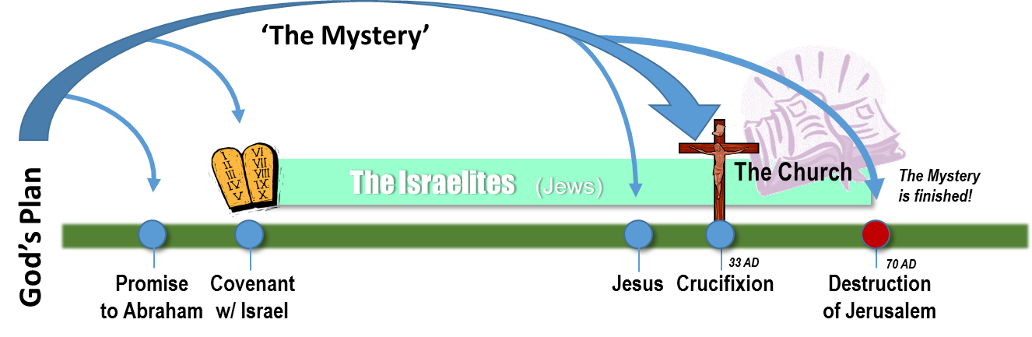
The Larger Biblical Context
Luke 21:20
“…these are days of vengeance, so that all things which are written will be fulfilled.”

Slide 5
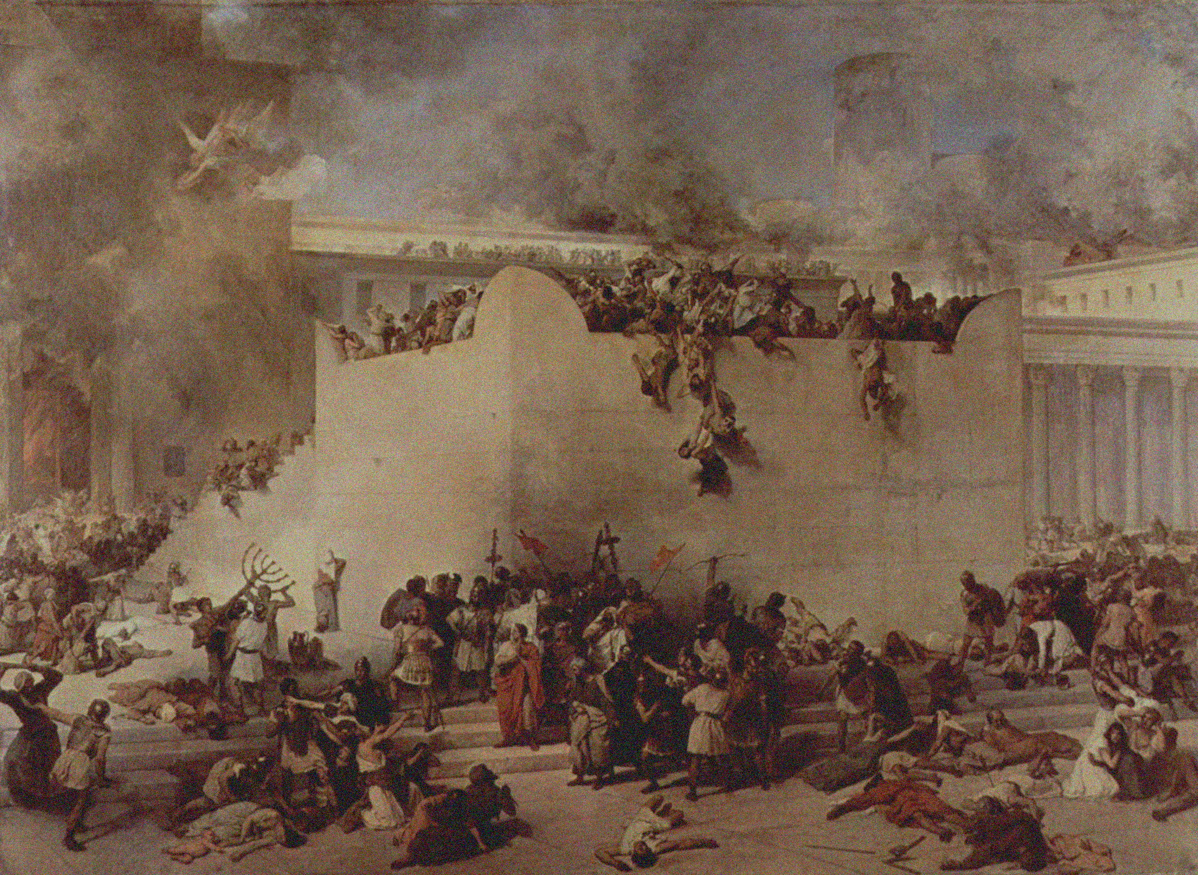
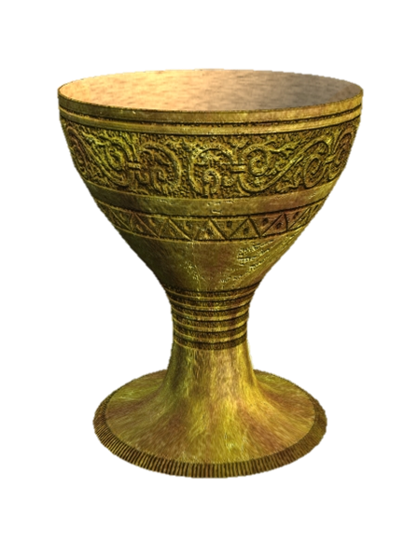
Matthew 23:32-3
“Fill up, then, the measure of the guilt of your fathers. 33 “You serpents, you brood of vipers, how will you escape the sentence of hell?
34 “Therefore, behold, I am sending you prophets and wise men and scribes; some of them you will kill and crucify, and some of them you will scourge in your synagogues, and persecute from city to city, 35 so that upon you may fall the guilt of all the righteous blood shed on earth, from the blood of righteous Abel to the blood of Zechariah, the son of Berechiah, whom you murdered between the temple and the altar.
36 Truly I say to you, all these things will come upon this generation.”
Jerusalem’s cup of Iniquity

Slide 6
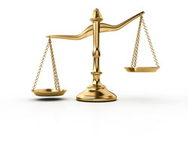
The Larger Biblical Context
Why the Jews of Jesus’ day?
“Fill up, then, the measure of the guilt of your fathers. 33 You serpents, you brood of vipers, how will you escape the sentence of hell? 34 Therefore, behold, I am sending you prophets and wise men and scribes; some of them you will kill and crucify, and some of them you will scourge in your synagogues, and persecute from city to city”
Matthew 23:32-34
Guilty of all the blood, Matt. 23:35
Judgment upon this generation, 23:36
Charged with all the blood,
Luke 11:49-51
Christ’s murderers, Acts 7:52-53
Heap up their sins to full capacity,
1 Thessalonians 2:14-16

Slide 7
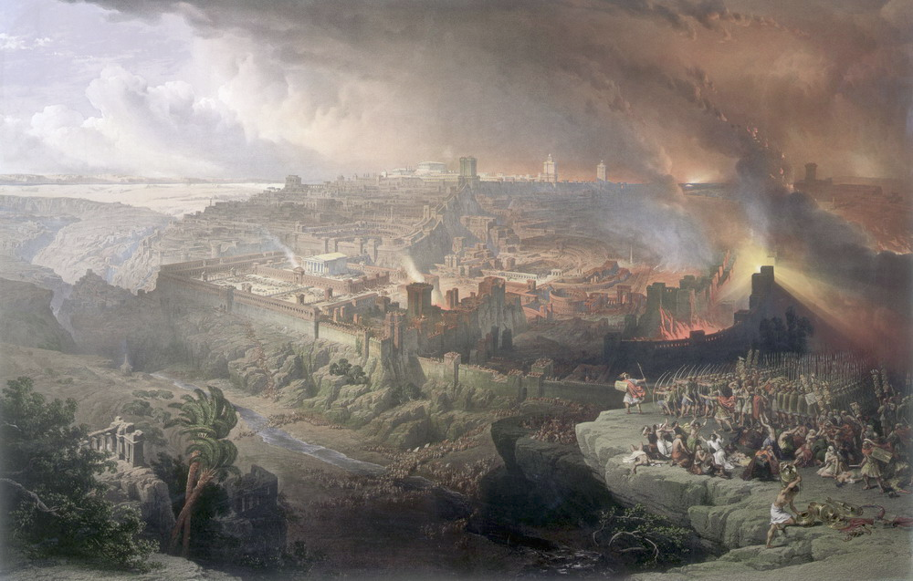
Matthew 24
TWO
Three Questions:
When will these things happen?
What will be the sign
  of Your coming?
  the end of the age?
24:34
Matthew 26:64
1 Corinthians 10:11
Hebrews 9:26
Jerusalem’s cup of Iniquity

Slide 8

Matthew 24
“But immediately after the tribulation of those days the sun will be darkened, and the moon will not give its light, and the stars will fall from the sky, and the powers of the heavens will be shaken. 30 And then the sign of the Son of Man will appear in the sky, and then all the tribes of the earth will mourn, and they will see the Son of Man coming on the clouds of the sky with power and great glory.”
Jerusalem’s cup of Iniquity

Slide 9
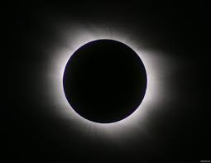
Apocalyptic Language
Sun being darkened, etc:
Isaiah 13:10, 13, 19-20
Son of Man coming on the clouds:
Isaiah 19:1-4; Jeremiah 4:13; Psalm 18:8-14
The promise to Caiaphas, Matt. 26:64
Jerusalem’s cup of Iniquity

Slide 10
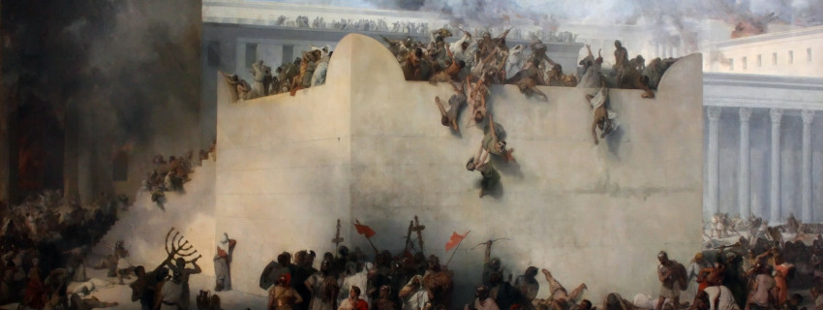
“Truly I say to you, this generation will not pass away until all these things take place.”
(Matthew 24:34)

Slide 11
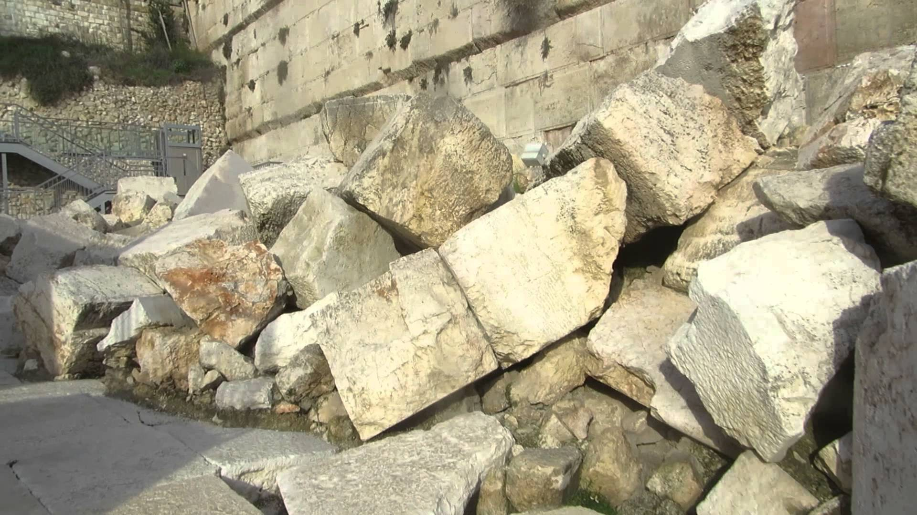
Siege of Jerusalem 70 AD

Slide 12
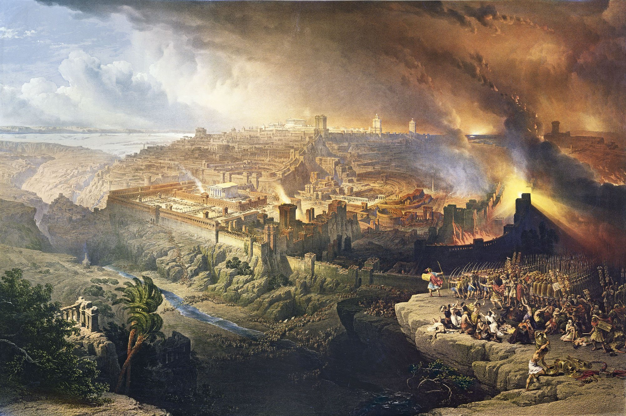


Slide 13
Revelation 1
Preamble: 1:1-20
  Greeting & Doxology; 1:1-8
  The Vision of the Son of Man; 1:9-20
    The Call; 1:9-11
    The Son of Man; 1:12
    The Commission; 1:17-20

Slide 14
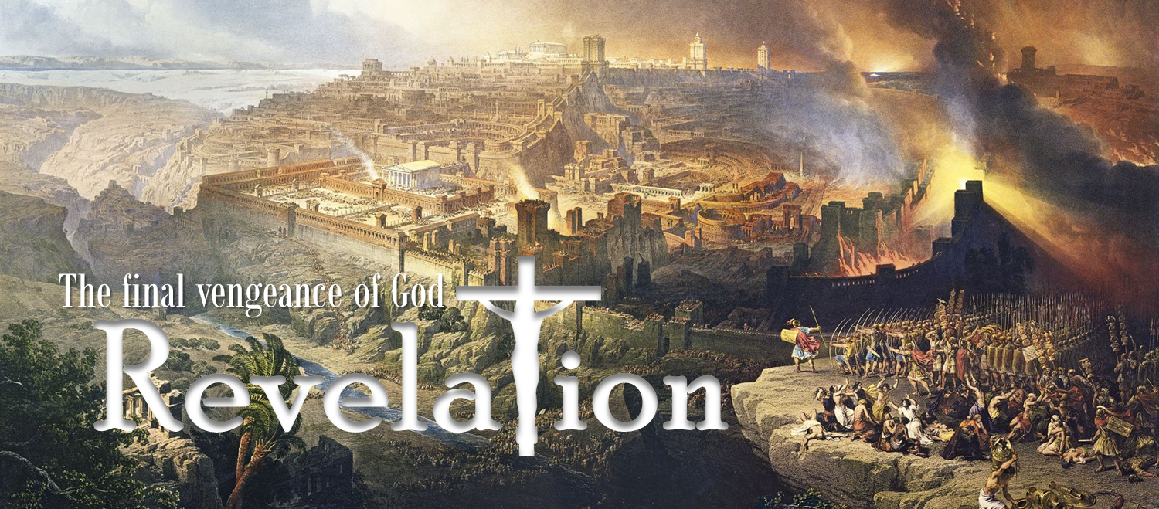
Isaiah 43:13
"Even from eternity I am He, and there
is none who can deliver out of My hand;
I act and who can reverse it?"

Slide 15

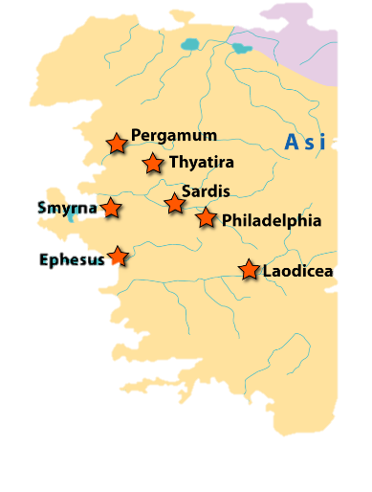
Revelation 1:4
John to the seven churches that are in Asia: Grace to you and peace, from Him who is and who was and who is to come; and from the seven Spirits who are before His throne; and from Jesus Christ…

Slide 16
Revelation 1:5-6
Jesus Christ
And from Jesus Christ, the faithful witness, the first-born from the dead, and the ruler of the kings of the earth.
To Him who loves us and released us from our sins by His blood, 6 and He has made us to be a kingdom, priests to His God and Father; to Him be the glory and the dominion forever and ever. Amen.
The faithful witness
The first-born from the dead
The ruler of the kings
Him who loves us
Him who released us
Him who made us to be a kingdom
Him who made us priests
to His God

Slide 17
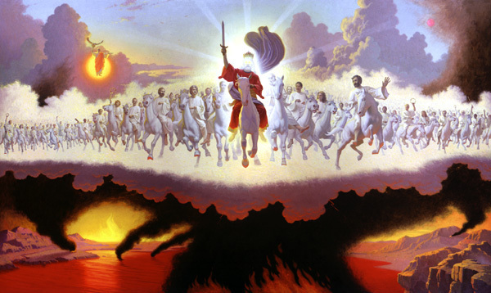
Revelation 1:7
7 Behold, He is coming with the clouds, and every eye will see Him, even those who pierced Him; and all the tribes of the earth will mourn over Him. So it is to be. Amen.
‘See’ means experience
(Mark 1:44; Luke 17:22; John 3:36)
All the tribes will mourn, Matthew 24:30

Slide 18
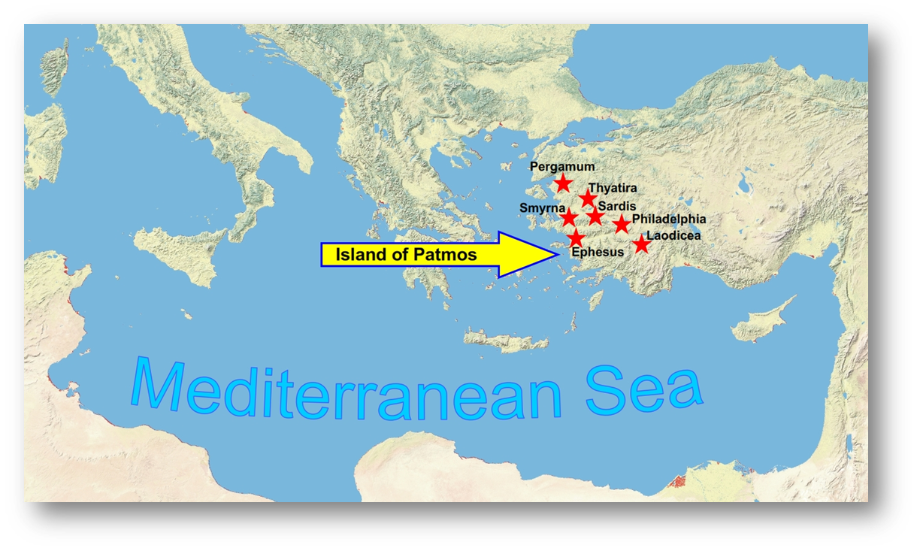
The Threefold Common Heritage
Tribulation (Acts 14:22)
Kingdom (Rev. 5:9,10)
Perseverance
Revelation 1:9
9 I, John, your brother and fellow partaker in the tribulation and kingdom and perseverance which are in Jesus, was on the island called Patmos because of the word of God and the testimony of Jesus.

Slide 19
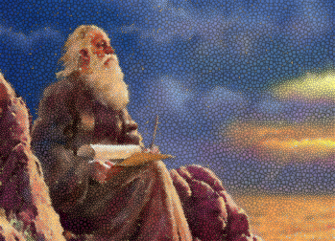
What John heard…
Revelation 1:10
10 I was in the Spirit on the Lord’s day, and I heard behind me a loud voice like the sound of a trumpet, 11 saying,
“Write in a book what you see, and send it to the seven churches: to Ephesus and to Smyrna and to Pergamum and to Thyatira and to Sardis and to Philadelphia and to Laodicea.”

Slide 20
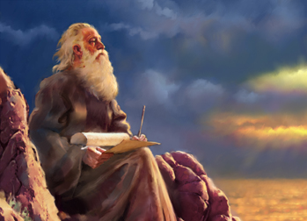
A clue to understanding this book:
“Write in a book what you see”
The information in this book was shown to John (signified’ 1:1) by Jesus. John is bearing witness to all that he ‘saw’ (1:2), by writing down everything he has ‘seen’ (1:19).
The Revelation is highly symbolic which requires an
understanding of the OT symbols and language that it contains.

Slide 21
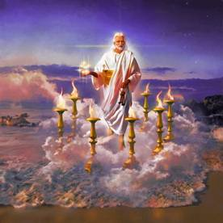
What John saw…
Revelation 1:9
12 Then I turned to see the voice that was speaking with me. And having turned I saw seven golden lampstands; 13 and in the middle of the lampstands
I saw one like a son of man…

Slide 22
‘one like a son of man…’
Revelation 1:13-16
…clothed in a robe reaching to the feet, and girded across His chest with a golden sash. 14 His head and His hair were white like white wool, like snow; and His eyes were like a flame of fire. 15 His feet were like burnished bronze, when it has been made to glow in a furnace, and His voice was like the sound of many waters. 16 In His right hand He held seven stars, and out of His mouth came a sharp two-edged sword; and His face was like the sun shining in its strength.
Ex. 28:4; 29:5; 39:27-29; Lev. 16:4
Daniel 7:9-10;
‘ancient of Days’
Pleiades: Job 9:5-9;
38:31-33; Amos 5:8.
Isaiah 11:4; Hebrews 4:12

Slide 23
Revelation 1:17-19
17 When I saw Him, I fell at His feet like a dead man. And He placed His right hand on me, saying,
  “Do not be afraid; I am the first and the last, 18 and the living One; and I was dead, and behold, I am alive forevermore, and I have the keys of death and of Hades. 19 Therefore write the things which you have seen, and the things which are, and the things which will take place after these things.”
Isaiah 41:4; 44:6
Isaiah 48:12
"Listen to Me, O Jacob, even Israel whom I called; I am He, I am the first, I am also the last.
Revelation 2:8
To the angel of the church in Smyrna write: These are the words of the First and the Last,
Revelation 22:13
I am the Alpha and the Omega, the First and the Last, the Beginning and the End."

Slide 24
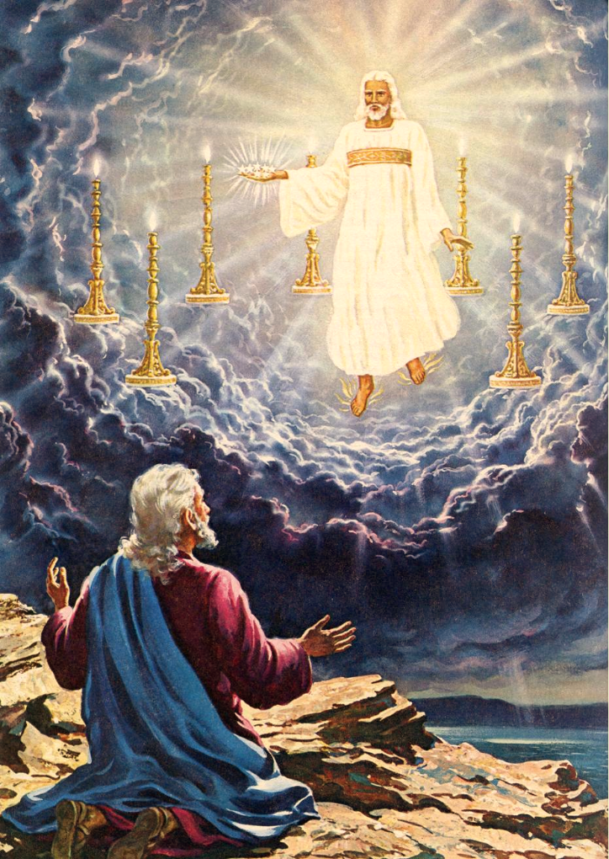
Revelation 1:20
20 As for the mystery of the seven stars which you saw in My right hand, and the seven golden lampstands:
the seven stars are the angels of
the seven churches, and the seven lampstands are the seven churches.

Slide 25


Revelation is a survival manual.
2:7 To him who overcomes, I will grant to eat of the tree of life
2:11 He who overcomes will not be hurt by the second death
2:17 To him who overcomes, to him I will give some of the hidden manna
2:26 He who overcomes, and he who keeps My deeds until the end,
TO HIM I WILL GIVE AUTHORITY OVER THE NATIONS
3:5 He who overcomes will thus be clothed in white garments
3:12 He who overcomes, I will make him a pillar in the temple of My God,
3:21 He who overcomes, I will grant to him to sit down with Me
on My throne,
21:7 He who overcomes will inherit these things, and I will be his God
and he will be My son.

Slide 26

Next Week:
  Chapter 2: The letters to the Seven churches of Asia

